Slide 1
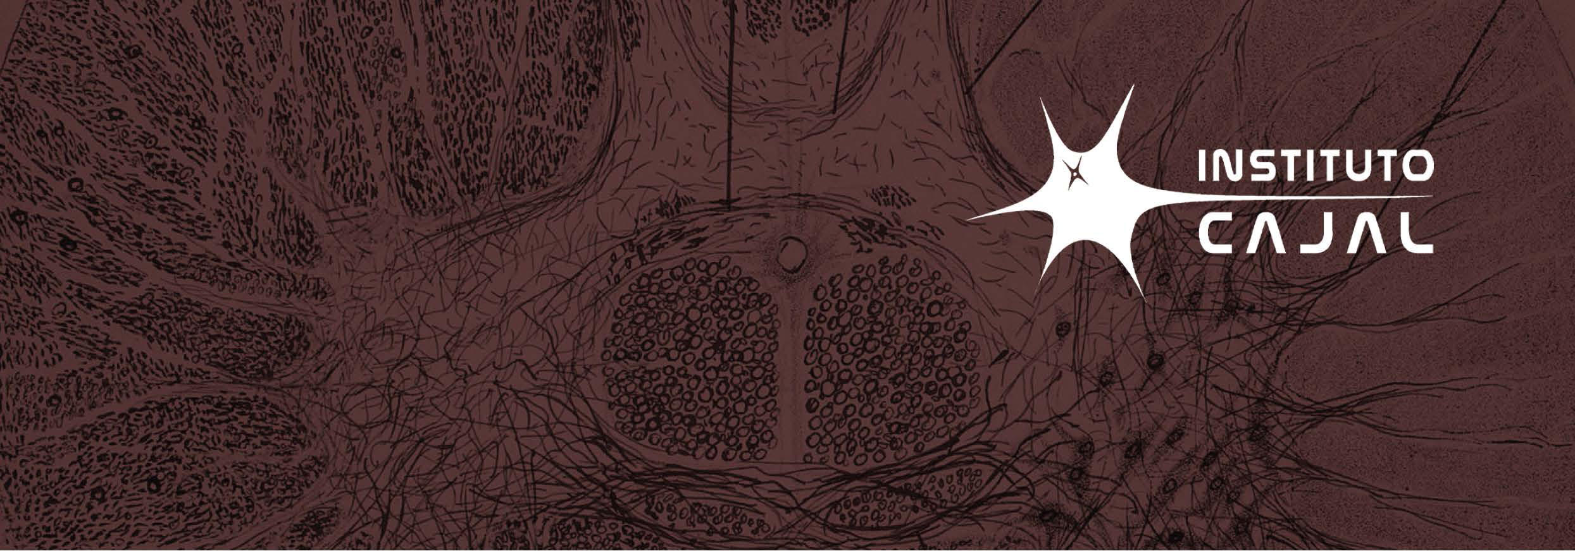
SEMINARIO PRESENCIAL
Viernes, 22 de Marzo de 2024
12:30 h. Instituto Cajal - CSIC
Dra. ANNA WILLIAMS
Centre for Regenerative Medicine, Institute for Regeneration and Repair, University of Edinburgh
UNLOCKING THE POTENTIAL OF
OLIGODENDROCYTES IN
NEURODEGENERATIVE DISORDERS
Abstract
Oligodendrocytes form the myelin within the brain and the spinal cord and have long been known to be heterogenous – in morphology, developmental origin and regionally. However, more recently, it has become clear that these cells are also heterogeneous in their transcriptome, suggesting differences in their functional capabilities. Single nucleus RNA sequencing has identified these differences in normal human brains, which are not identical to mice oligodendrocytes and these are different again in post mortem brains of people with MS. Recently, we have expanded this analysis to include more samples from more people with MS, finding patterns of responses between donors suggesting different pathological/regenerative responses, suggesting possible ways to stratify patients. We can use this knowledge to understand disease (MS and vascular dementia where demyelination also occurs) and to design ways to functionally aid oligodendrocytes to repair myelin and protect neural networks better.
Affiliation and short bio
Anna is Professor of Regenerative Neurology and runs a research group in the Institute of Regeneration and Repair at the University of Edinburgh. She is also a consultant neurologist, with a busy clinic in the Anne Rowling Regenerative Neurology Clinic. Anna did her medical training at the University of Edinburgh, also with a bachelor’s degree in Pathology. She carried out a PhD in the laboratory of Prof Peter Brophy, on the action of Periaxin in inherited peripheral nerve demyelinating diseases. After a few more years as a doctor, she then moved to Paris, France for a post-doctoral position in the laboratory of Prof. Catherine Lubetzki, where she moved into studying myelin in the context of multiple sclerosis. She moved back to Edinburgh to start her own research group in 2008, funded by the Wellcome Trust, and then by the Chief Scientist’s Office. She received her personal chair in Regenerative Neurology in 2016. Her research group is interested primarily in understanding how the myelin of the central nervous system is maintained and repaired in diseases such as multiple sclerosis and cerebral small vessel disease, with the ultimate aim of trying to improve this and therefore improve patient therapies.

Slide 2
Related publications with the topic
Macnair W, Calini D, Agirre E, Bryois J, Jäkel S, Kukanja P, Stokar-Regenscheit N, Ott V, Foo LC, Collin L, Schippling S, Urich E, Nutma E, Marzin M, Amor S, Magliozzi R, Heidari E, Robinson MD, ffrench-Constant C*, Castelo-Branco G*, Williams A*, Malhotra D*. Single nuclei RNAseq stratifies multiple sclerosis patients into three distinct white matter glia responses bioRxiv 2022.04.06.487263; * equal last author doi: https://doi.org/10.1101/2022.04.06.487263
Seeker LA, Bestard-Cuche N, Jäkel S, Kazakou NL, Bøstrand SMK, Wagstaff LJ, Cholewa-Waclaw J, Kilpatrick AM, Van Bruggen D, Kabbe M, Baldivia Pohl F, Moslehi Z, Henderson NC, Vallejos CA, La Manno G, Castelo-Branco G, Williams A. Brain matters: unveiling the distinct contributions of region, age, and sex to glia diversity and CNS function. Acta Neuropathol Commun. 2023 May 22;11(1):84. doi: 10.1186/s40478-023-01568-z.
Quick S, Procter TV, Moss J, Lawson A, Baker S, Walton M, Mohammad M, Mungall W, Onishi A, Tobola Z, Stringer M, Jansen MA, Vallatos A, Giarratano Y, Bernabeu MO, Wardlaw JM, Williams AC. An intrinsic endothelial dysfunction causes cerebral small vessel disease. Acta Neuropathol. 2022 May 30. doi: 10.1007/s00401-022-02441-4.
Neely SA, Williamson JM, Klingseisen A, Zoupi L, Early JJ, Williams A, Lyons DA. New oligodendrocytes exhibit more abundant and accurate myelin regeneration than those that survive demyelination. Nat Neurosci. 2022 Apr;25(4):415-420. doi: 10.1038/s41593-021-01009-x. Epub 2022 Feb 14. PMID: 35165460; PMCID: PMC7612594.

